Slide 1


ELECTRONIC COMPONENTS AND DEVICES

Slide 2
Electronic Components

Slide 3
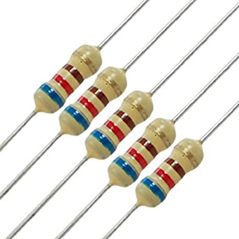
Resistors

Slide 4
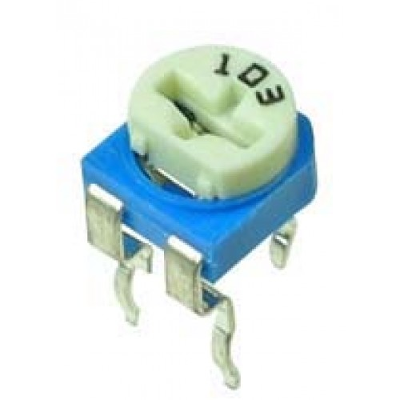
Potentiometer

Slide 5
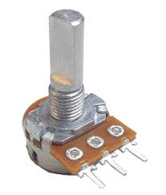
Rotary Potentiometer

Slide 6
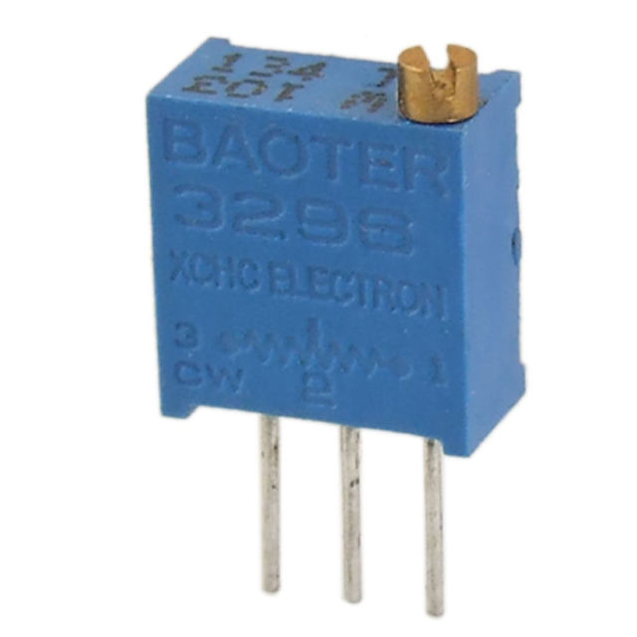
Trimmer

Slide 7
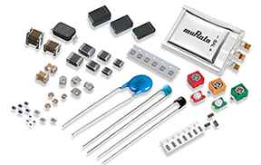
Capacitors

Slide 8
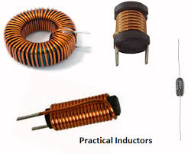
Inductors

Slide 9
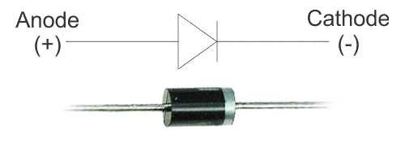
Diode

Slide 10
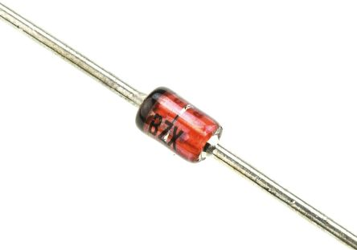
Zener Diode

Slide 11
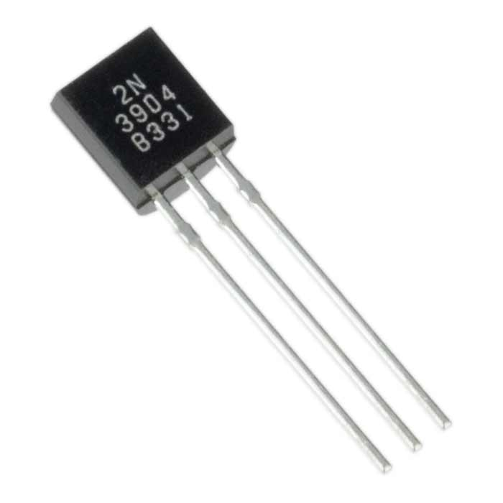
Transistor

Slide 12
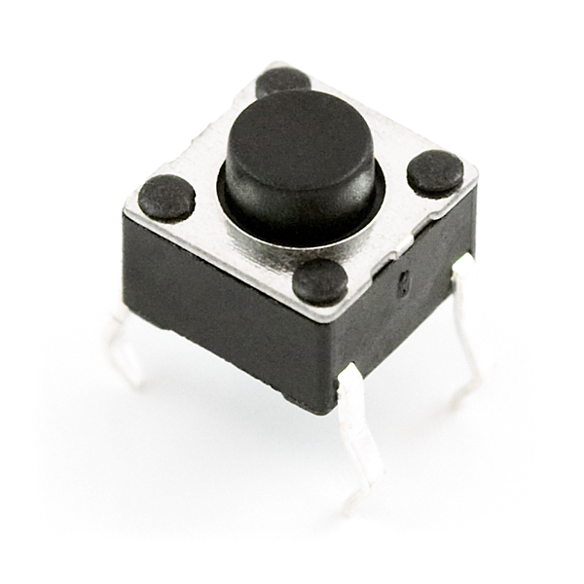
Push Button

Slide 13
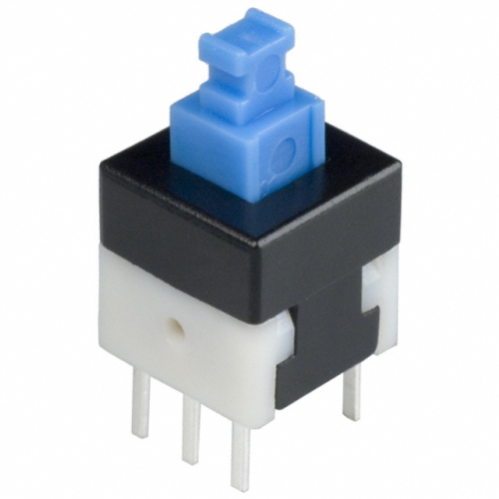
Push to ON - Push to OFF Switch

Slide 14
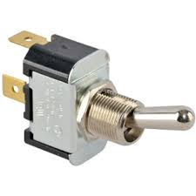
Toggle Switch

Slide 15
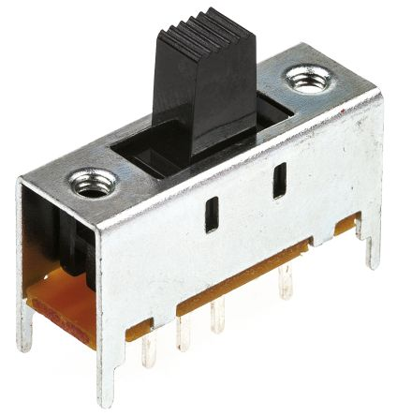
Slide Switch

Slide 16
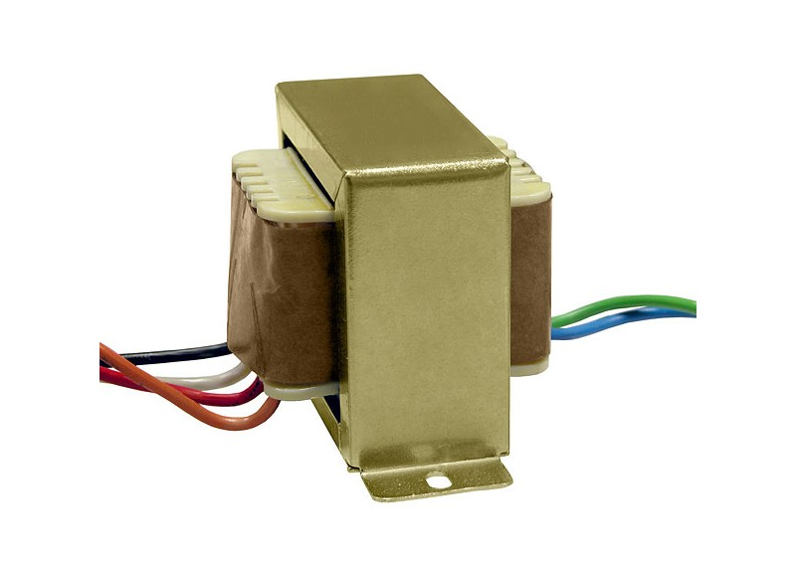
Transformer

Slide 17
ARDUINO BOARDS

Slide 18
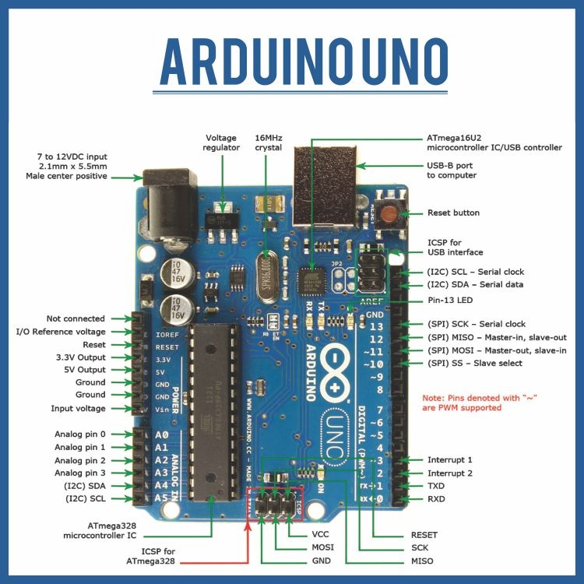
Arduino UNO

Slide 19
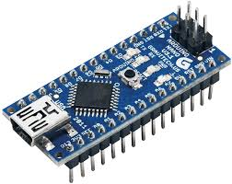
Arduino NANO

Slide 20
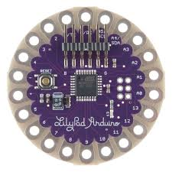
Arduino Lilypad

Slide 21
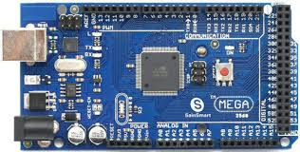
Arduino MEGA

Slide 22
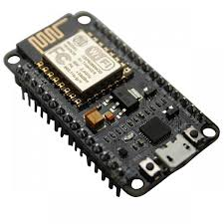
nodeMCU

Slide 23
SENSORS

Slide 24
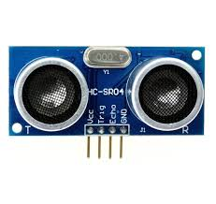
Ultrasonic Sensor

Slide 25
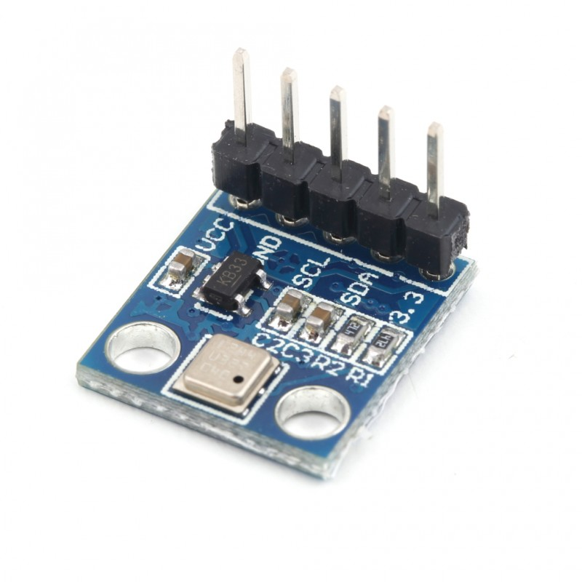
Pressure Sensor – BMP 180

Slide 26
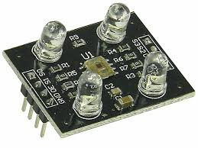
Color Sensor

Slide 27
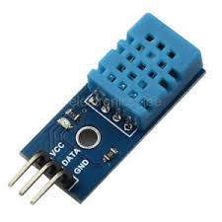
Temperature and Humidity Sensor – DHT11

Slide 28
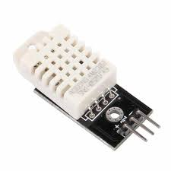
Temperature and Humidity Sensor – DHT22

Slide 29
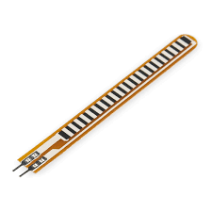
Flex Sensor

Slide 30
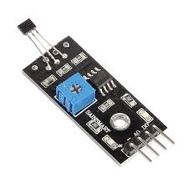
Hall Effect Sensor

Slide 31
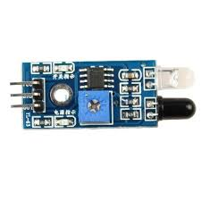
IR Sensor

Slide 32
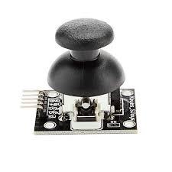
Joystick Module

Slide 33
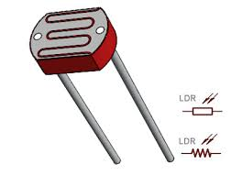
Light Dependent Resistor

Slide 34
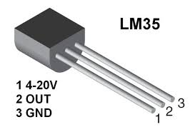
Temperature Sensor – LM35

Slide 35
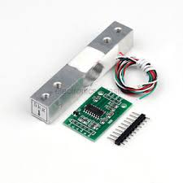
Load Cell

Slide 36
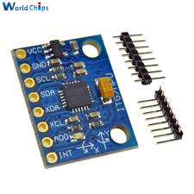
MPU 6050 Accelerometer

Slide 37
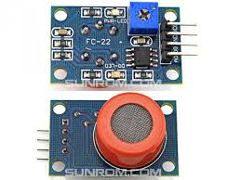
GAS Sensor – MQ3

Slide 38
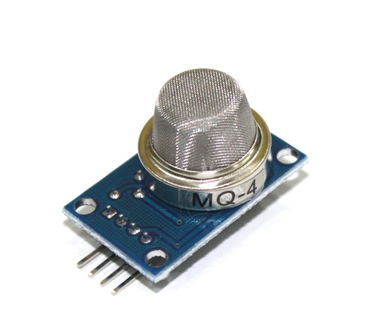
GAS Sensor – MQ4

Slide 39
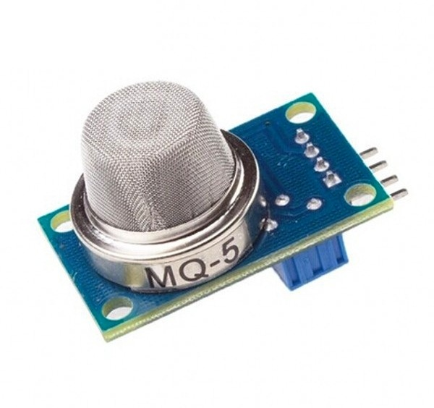
GAS Sensor – MQ5

Slide 40
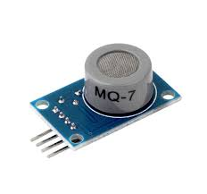
GAS Sensor – MQ7

Slide 41
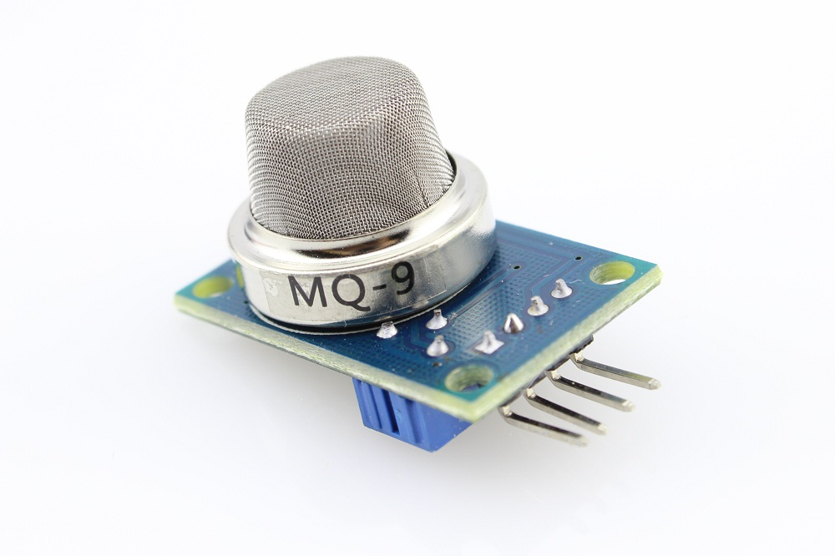
GAS Sensor – MQ9

Slide 42
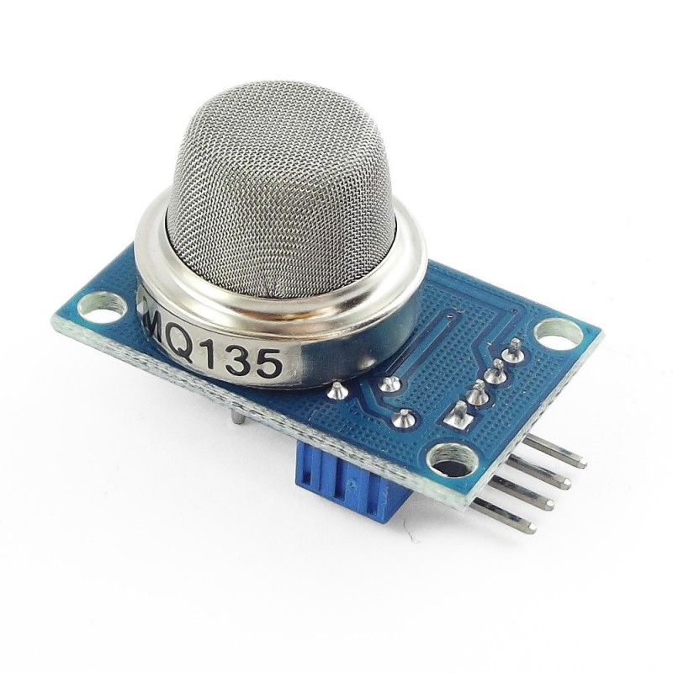
GAS Sensor – MQ135

Slide 43
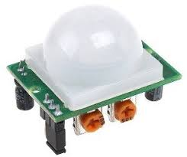
PIR Motion Sensor

Slide 44
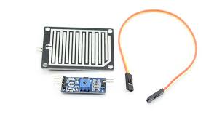
Rainfall Sensor – FC37

Slide 45
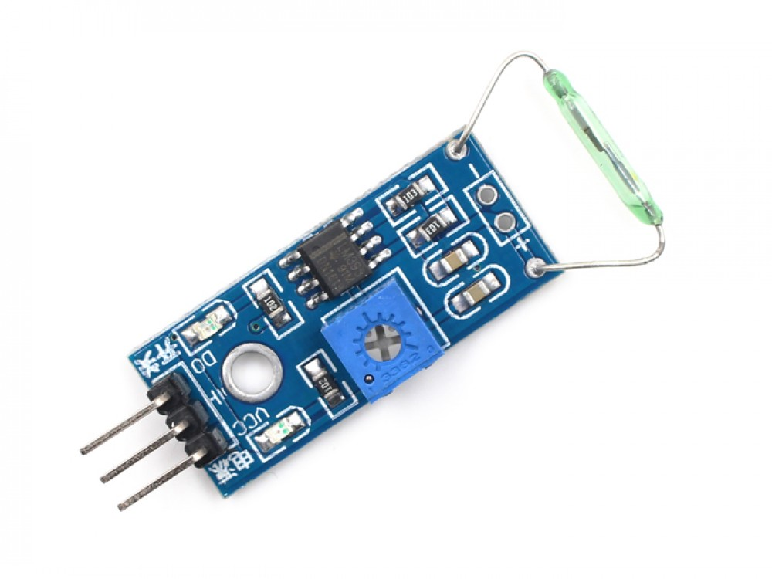
Reed Switch

Slide 46
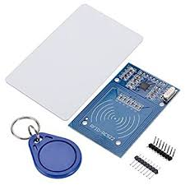
MFRC 522 RFID Sensor

Slide 47
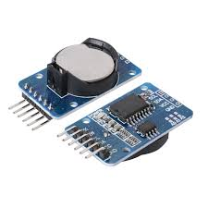
Real Time Clock DS1307

Slide 48
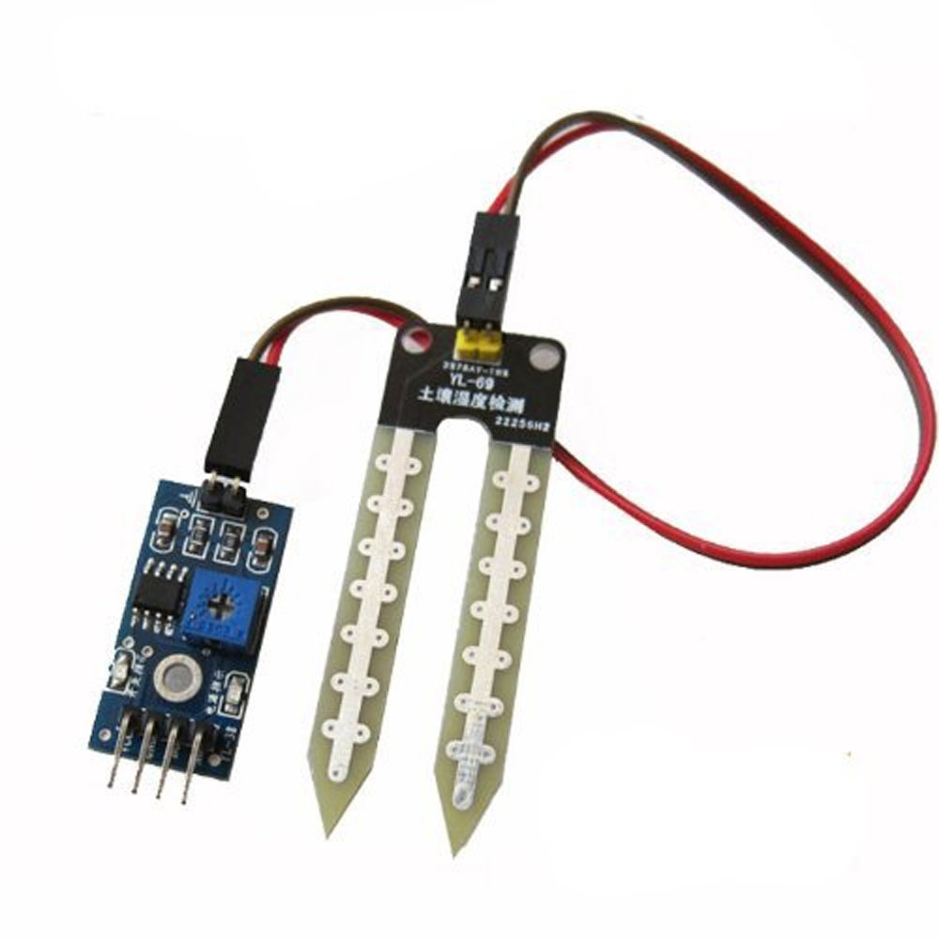
Soil Moisture Sensor

Slide 49
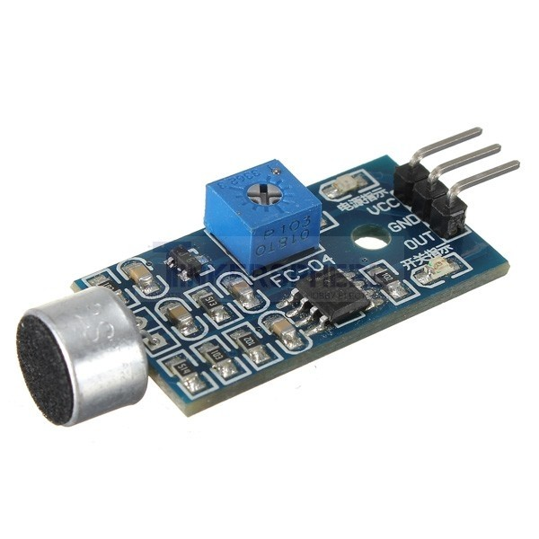
Sound Sensor

Slide 50
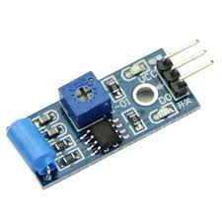
Tilt Sensor

Slide 51
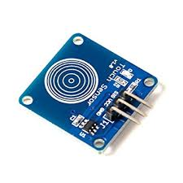
Touch Sensor

Slide 52
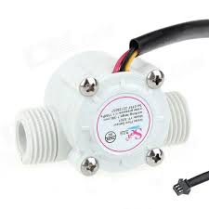
Water Flow Sensor

Slide 53
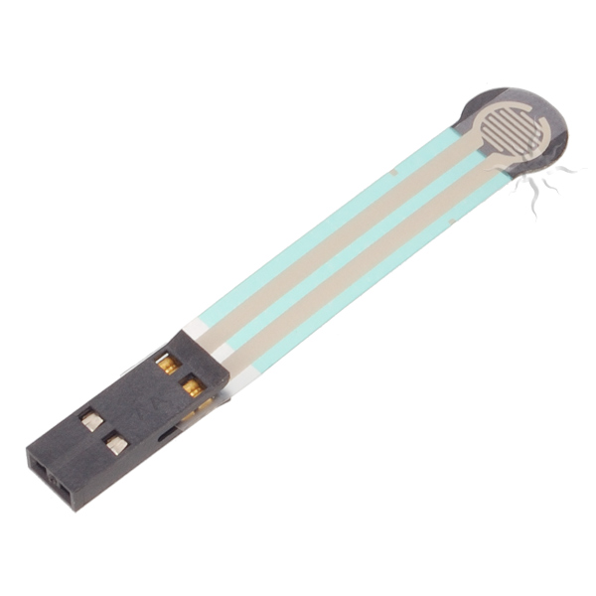
Force Sensor

Slide 54
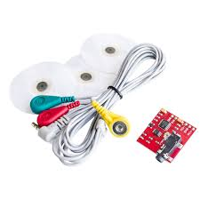
Electromyography – Muscle Sensor

Slide 55
Communication and Storage Devices

Slide 56

Bluetooth – HC05

Slide 57

XBee Communication Model

Slide 58

Sensor Name

Slide 59
Connectors

Slide 60

Sensor Name

Slide 61

Sensor Name

Slide 62

Sensor Name

Slide 63

Sensor Name

Slide 64

Sensor Name

Slide 65

Sensor Name

Slide 66

Sensor Name

Slide 67

Sensor Name

Slide 68

Sensor Name

Slide 69
Electronic Devices

Slide 70

Sensor Name

Slide 71

Sensor Name

Slide 72

Sensor Name

Slide 73

Sensor Name

Slide 74
Displays

Slide 75

Sensor Name

Slide 76

Sensor Name

Slide 77

Sensor Name

Slide 78
Motors and Motor Drivers

Slide 79

Sensor Name

Slide 80

Sensor Name

Slide 81

Sensor Name

Slide 82

Sensor Name

Slide 83

Sensor Name

Slide 84

Sensor Name

Slide 85

Sensor Name

Slide 86

Sensor Name

Slide 87

Sensor Name

Slide 88

Electronic Tools

Slide 89

Sensor Name

Slide 90

Sensor Name

Slide 91

Sensor Name

Slide 92

Sensor Name

Slide 93

Sensor Name

Slide 94

Sensor Name

Slide 95

Sensor Name

Slide 96

Thank You!

Slide 97
Sensor Name
Sensor Picture

Slide 98
Sensor Name
Sensor Picture

